Slide 1


SQL Troubleshooting: CPU

Slide 2

Part 3: Parallelism
“Many hands make light work.”

Slide 3
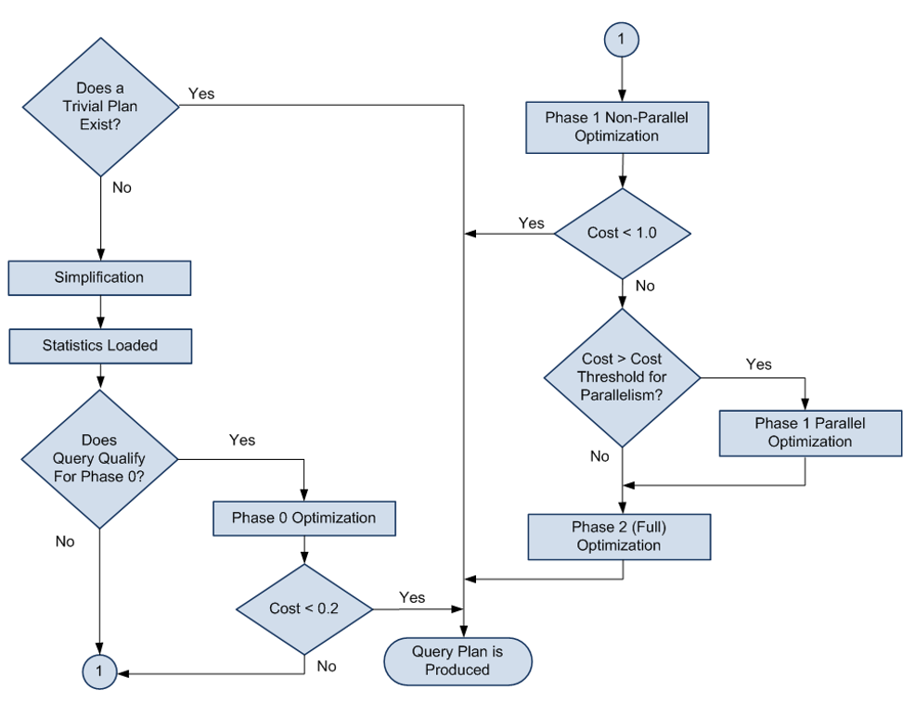
SQL Server Optimization Process
The SQL optimizer may go through 4 phases to optimize a query:
Pre-optimization/Trivial Plan phase
Phase 0
Phase 1
Phase 2
During “Phase 1” (red box in the diagram) of the query optimization process, the SQL Optimizer decides whether to use a serial or parallel plan by comparing the estimated cost of a serial plan versus the Cost Threshold For Parallelism (CTFP) Instance-level setting.
If the SQL Optimizer opts for a parallel plan, multiple CPUs will be used to run the query.
The number of CPUs a parallel plan can use is determined by many factors including an Instance-level setting called Maximum Degree of Parallelism (MAXDOP).
How many CPUs = MAXDOP
Estimated subtree cost vs. CTFP
Notes:
PRE-OPTIMIZATION: The fi rst stage is known as pre-optimization, and queries drop out of the process at this stage
when the statement is simple enough that there can only be one optimal plan, removing the need for
additional costing. Basic queries with no joins are regarded as “simple,” and plans produced as such
have zero cost (because they haven’t been costed) and are referred to as trivial plans.
Phase 0 — During this phase the optimizer looks at nested loop joins and won’t consider parallel operators.
The optimizer will stop here if the cost of the plan it has found is < 0.2. A plan generated at this phase is known as a transaction processing, or TP, plan.
Phase 1 — Phase 1 uses a subset of the possible optimization rules and looks for common patterns for which it already has a plan.
The optimizer will stop here if the cost of the plan it has found is < 1.0. Plans generated in this phase are called quick plans.
This is where the Optimizer considers parallel plan by comparing the cost of a serial plan vs. CTFP.
Phase 2 — This final phase is where the optimizer pulls out all the stops and is able to use all of its optimization rules. It also looks at parallelism and indexed views (if you’re running Enterprise Edition).
Completion of Phase 2 is a balance between the cost of the plan found versus the time spent optimizing.
Plans created in this phase have an optimization level of “Full.”

Slide 4
Cost Threshold for Parallelism
Instance-level Setting
Threshold at which a parallel plan is considered
Can be set from 0 to 32767
Default = 5
Compared against estimated subtree cost of the entire serial plan (not one operator)
Abstracted unit of cost (not time!)
Lower value = induce parallelism; Higher value = inhibits parallelism
Changing this setting does not require a restart

Slide 5
What is MAXDOP and how to configure it
A SQL Server configuration to limit the maximum number of processors SQL can use for executing a parallel query plan.
Configure the max degree of parallelism (MAXDOP) - Azure SQL Database | Microsoft Learn
Instance-level
EXEC sp_configure 'max degree of parallelism', 16;
Database-scoped
ALTER DATABASE SCOPED CONFIGURATION SET MAXDOP = 16 ;
Query Hint
SELECT ProductID, OrderQty, SUM(LineTotal) AS Total
FROM Sales.SalesOrderDetail
WHERE UnitPrice < $5.00
GROUP BY ProductID, OrderQty
ORDER BY ProductID, OrderQty
OPTION (MAXDOP 16);
GO
Resource Governor
CREATE WORKLOAD GROUP newReports
WITH
(REQUEST_MAX_MEMORY_GRANT_PERCENT = 2.5
, REQUEST_MAX_CPU_TIME_SEC = 100
, MAX_DOP = 16)
USING "default" ;
GO

Slide 6
Other ways to limit DOP
DOP Feedback (SQL 2022 only)
Part of Intelligent Query Processing
Available worker threads
The number of available threads can influence the DOP of a query.
CPU Affinity
Processor affinity configuration must allow SQL Server to use at least two processors
Logical CPU
Ultimately, the number of logical processors limits DOP
Dynamically lowers DOP of query to improve performance.

Slide 7
Other things that inhibit Parallelism
Scalar UDF
Remote query
Dynamic Cursors
Recursive Queries
TOP keyword

Slide 8
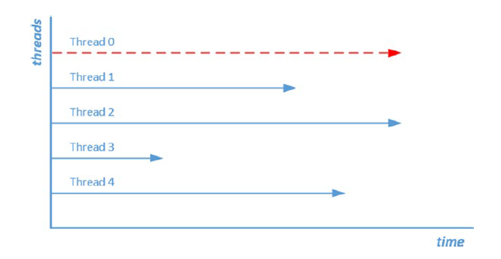
When Parallelism goes bad
Parent/Coordinating thread
Parallelism is meant to improve the performance of a query by dividing the workload across multiple CPUs.
However, there are times when parallelism can cause performance issues, such as when the distribution of workload across the CPUs is uneven.
As a result, worker threads may be waiting on each other to complete. The overhead of coordinating the parallel operation now becomes a problem in itself.
In these cases, limiting the MAXDOP can help mitigate the performance impact of over-parallelism.
High CXPACKET wait time
Uneven workload

Slide 9
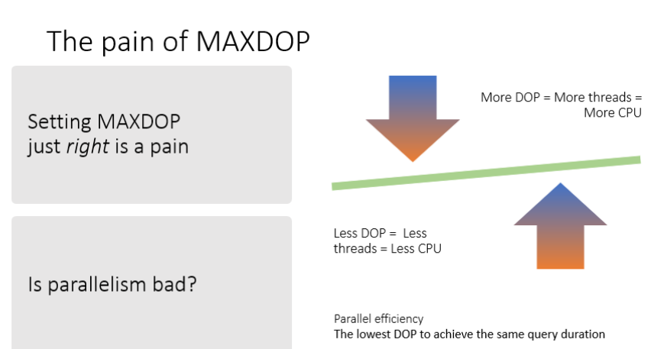
What’s the right MAXDOP setting?
Caveats of manually setting MAXDOP
Set it too high, you can run into CPU issues (e.g., Thread starvation)
Set it too low, you can miss out on performance benefits of parallelism
Reactive – would only be changed when there is a problem
Determining optimal DOP for each query in the workload can be time-consuming and arduous; requires code-change

Slide 10
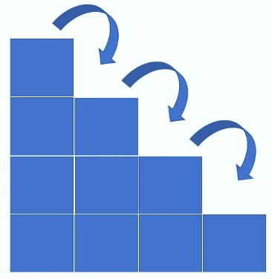
Introducing DOP Feedback
A feature that analyzes any parallel query and determines if it might perform better with a lower degree of parallelism than what is currently being used.
NOTE: DOP Feddback does not change the plan, only the DOP value
Sits between RG and Thread Availability
It works at the Plan-level
Iterative and Incremental
Uses a pre-defined DOP array of values
No. of Threads Available
Query 1
Validate
Analyze
{
128,
104
80,
64,
48,
32,
20,
16,
12,
8,
6,
4,
2
}
DOP Feedback
Resource Governor
Plan 1
Plan 2
Query hint
Provide Feedback
Database-level
Feedback 1
Feedback 2
Instance-level
Notes:
“Sits between RG and Thread Availability”
Priority order of how SQL currently implements DOP
If you’ll notice, all the existing methods are plan specific but system level configurations.
This means one DOP for all queries
Not ideal since some queries may benefit from large DOP values while some do not need as much
This is where DOP feedback comes in. It offers the most granular way of controlling DOP – at the plan level.
DOP feedback is still dependent on available thread
DOP feedback will not go beyond what’s available and cause thread starvation
“It works at the Plan-level”
If you have a query that generates multiple plans (e.g. non-parameterized query), DOP feedback will be provided for each query plan, despite them being based on the same query.
“Iterative and Incremental”
ITERATIVE: Provides feedback repeatedly until the optimal DOP is determined
INCREMENTAL: Reduces (never increases) DOP in a stepwise or incremental fashion
“Uses a pre-defined DOP array”
- This method is to avoid too many iterations due to too many DOP incremental values. For example, if current/default DOP is 32 and optimal is 8, you don’t want SQL to iterate starting with 32, then 31, 30, 29, and so on.

Slide 11
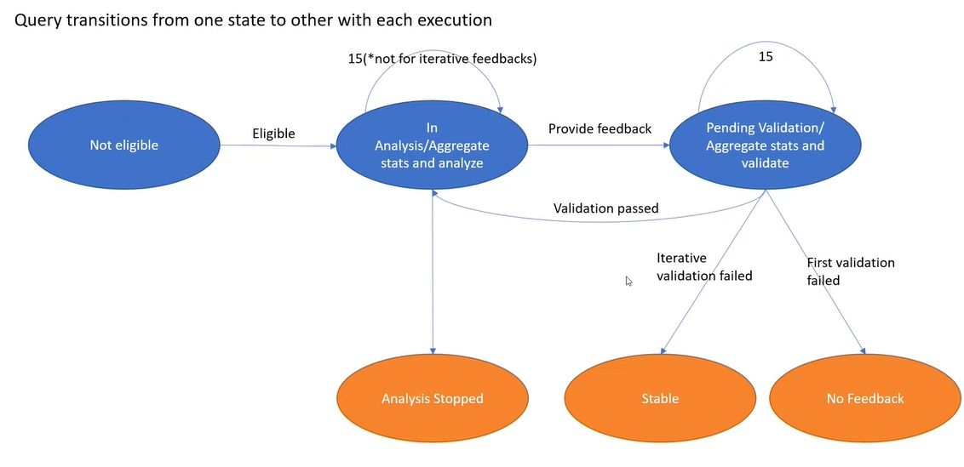
DOP Feedback Workflow
Notes:
PHASE 1: Eligibility check
- See eligibility criteria in next slide
PHASE 2: Analyze/Aggregate stats
STATS = Query execution stats: CPU Time, elapsed time)
Query needs to run at least 15 times to trigger a feedback
There might be times when DOP Feedback would require more than 15 executions if it involves transient and interrupted executions
Stats are aggregated (standard deviations and averages are calculated)
This is necessary because the stats can vary per execution of the same query
PHASE 3: Provide first Feedback
At this stage, query will run with the new DOP
SQL will let the query run 15 times
Stats aggregation and analysis will once again take place and result will be compared to the baseline stats (collected on Phase #2)
If result shows improved performance, it will consider VALIDATON = PASSED
It will the go back to Phase: 2, but DOP Feedback engine will no longer wait for 15 executions to provide the next incremental feedback
This iterative process will continue until there is “VALIDATION FAILED”, which means the DOP value no longer leads to an improvement or may have led to a regression.
Whatever DOP value that is, will be chosen as the “stable” DOP
The iterative process will stop at this point and move to the “Stable” state
“Analysis Stopped”
Can happen when there is a need to throttle DOP (e.g., when server is under CPU pressure or there is thread starvation)
Can happen when there is high variance in the std dev across the 15 executions (>= 20% of avg.). In that case, DOP Feedback would not be able to confidently recommend an optimal DOP setting.
Can happen when there is already “High Parallelism Efficiency”. Meaning, current DOP is already optimial.
This is checked during the first Analysis (Phase 1), which means it can be considered as an eligibility criteria.
Parallelism Efficiency = The lowest DOP to achieve the same query duration
Parallelism Efficiency = CPU_time / Adj_Elapsed_Time * DOP
Arbitrary threshold is .7

Slide 12
Eligibility Criteria
Query has been captured by Query Store
Must be a successful execution
Not a system query
Only SELECT statements
Doesn’t have a recompile or disable_dop_feedback hint
Query DOP > 2 and <= 128
“Adjusted” elapsed time >= 10 secs.
Only “fresh” queries (i.e., compiled or recompiled)
Notes:
Only queries captured or stored in QDS are eligible
Cancelled or aborted executions are not eligible
System queries are not eligible
Only SELECT queries are eligible
Queries with a default DOP > 2 and <= 128 are eligible
“Adjusted” elapsed time removes non-parallelism-related waits (BUFFERLATCH, BUFFERIO, NETWORKIO)
Queries already in the procedure cache are no longer considered until they are recompiled

Slide 13
Supportability
XEvents: 7 new events
dop_feedback__eligible_query
dop_feedback__analysis_stopped
dop_feedback__provided
dop_feedback__validation
dop_feedback__stabilized
dop_feedback__reverted
dop_feedback__reassessment_failed
Helps in understanding which state the query currently is within the DOP Feedback workflow
DMVs: sys.query_store_plan_feedback
Where feedback is persisted.
Query Hint:
Option(USE HINT(‘DISABLE_DOP_FEEDBAK’))
DB Scoped Config:
ALTER DATABASE SCOPED CONFIGURATION SET DOP_FEEDBACK = OFF
Server Level Feature Switch:
Default state = ON
dbcc traceon(12061, -1)
SHOWPLAN XML:
New attributed: “IsDOPFeedbackAdjusted” Reflects whether or not the feedback has been applied for the current execution.
Valid Values:
“Yes: Adjusting”
“Yes: Stable”
“No Feedback”

Slide 14

Demo

